Slide 1

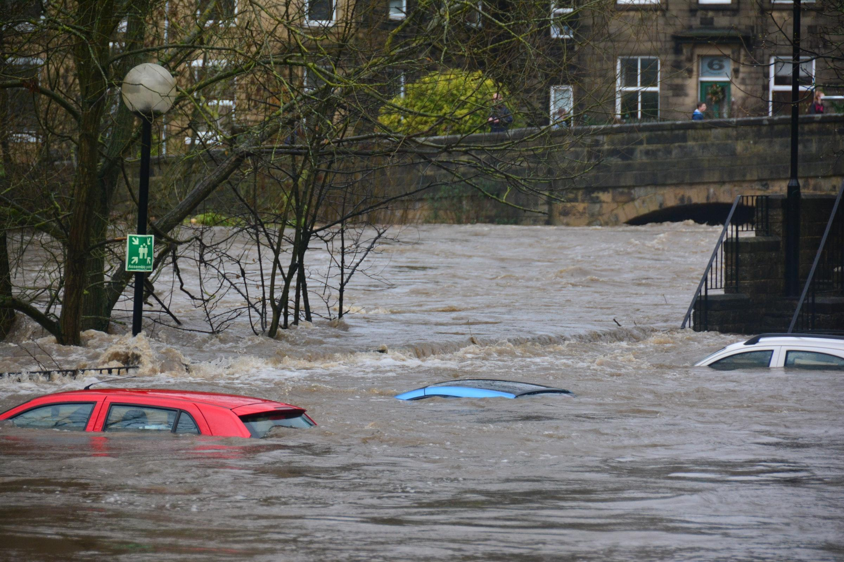
Natural Hazards
Introduction to Natural Hazards
Classroom & Distance Learning
Google Classroom

Slide 2
Lesson Roadmap - Recommended
Time (% of lesson) | Lesson Element
0%-5% | Starter Activity This is intended to have students engaged and intrigued from the moment they walk into the classroom, thereby helping to manage behaviour effectively.
5%-50% | Learning Perhaps initially teacher-led but always predominantly student-focused
50%-55% | Mini Plenary Teacher applies assessment for learning - perhaps some off-the-cuff quiz questions, or a mini-whiteboard activity.
55%-95% | Application of Learning Students work through a series of graded tasks / questions in order to test their knowledge of what they self-learned or peer learned/taught. Creative writing element can be a homework option due to time constraints.
95%-100% | Final Plenary Check student progress against class objectives

Slide 3
Starter Activity

Slide 4
Starter Activity
Where do you think this is?
What has happened?
Why has this happened?
Stretch & Challenge
How has this impacted people?
Who is most affected?
Notes:
Starter activity intended to gauge the focus and interest of students immediately.

Slide 5
Learning
& Mini-Plenary

Slide 6
Natural Hazards
Introduction to Natural Hazards

Slide 7
Lesson Objectives
In today’s class, we will:
Find out what a natural hazard is.
Identify how natural hazards are threats to people and property.
Pinpoint the two main types of natural hazards.
Identify the different factors which affect hazard risk.
Notes:
Lesson objectives will be readdressed in the final plenary stage of the class. Final Plenary links back to lesson objectives for teacher to assess learner progress.

Slide 8
A Natural Hazard is a Threat to People or Propertry

Slide 9
What is a Natural Hazard?
A natural hazard is a natural process which can cause injury, death or turmoil for humans, or destroy property and wildlife habitats
A natural disaster is a natural hazard than has actually occurred
Extreme events which do not present a threat to human activity are not regarded as hazards (e.g. flooding on an uninhabited island, or an avalanche in Antarctica)
Notes:
Intro slide for students - teacher can illicit for ideas.

Slide 10
You often see natural hazards on the news!
Some natural hazards, such as flooding, can occur anywhere in the world. Other natural hazards however, such as tornadoes, can only happen in specific parts of the world. There are also some hazards that require climatic or tectonic conditions to occur, for example tropical storms or volcanic eruptions
Human activities can influence how often particular natural hazards happen and how severe they are. By understanding when, where, why and how natural hazards occur can help all of us to understand how to minimise the impact they have on our lives

Slide 11
There are Two Main Types of Natural Hazard

Slide 12
Most Natural Hazards can be divided into two main categories
Geological Hazards
Geological Hazards are caused by land and tectonic processes.
These include:
?
2. Meteorological Hazards
Meteorological Hazards are caused by weather and climate.
These include:
?
Notes:
Students have to start thinging about the two different categories of hazards - activity on next page.

Slide 13

Pairwork task: Brainstorm
Produce a mind map like this to generate ideas about the types of hazards:
Geological Hazards
Meteorological Hazards
Notes:
Students to be given3-4 minutes to brainstorm. Feedback to class. Teacher to annotate on whiteboard to collate all student ideas.

Slide 14
Most Natural Hazards can be divided into two main categories
Geological Hazards
Geological Hazards are caused by land and tectonic processes.
These include:
Volcanoes
Earthquakes
Landslides
Avalanches
2. Meteorological Hazards
Meteorological Hazards are caused by weather and climate.
These include:
Tropical storms
Extreme weather e.g. heatwaves and cold spells
droughts
Notes:
Students check their ideas against these.

Slide 15
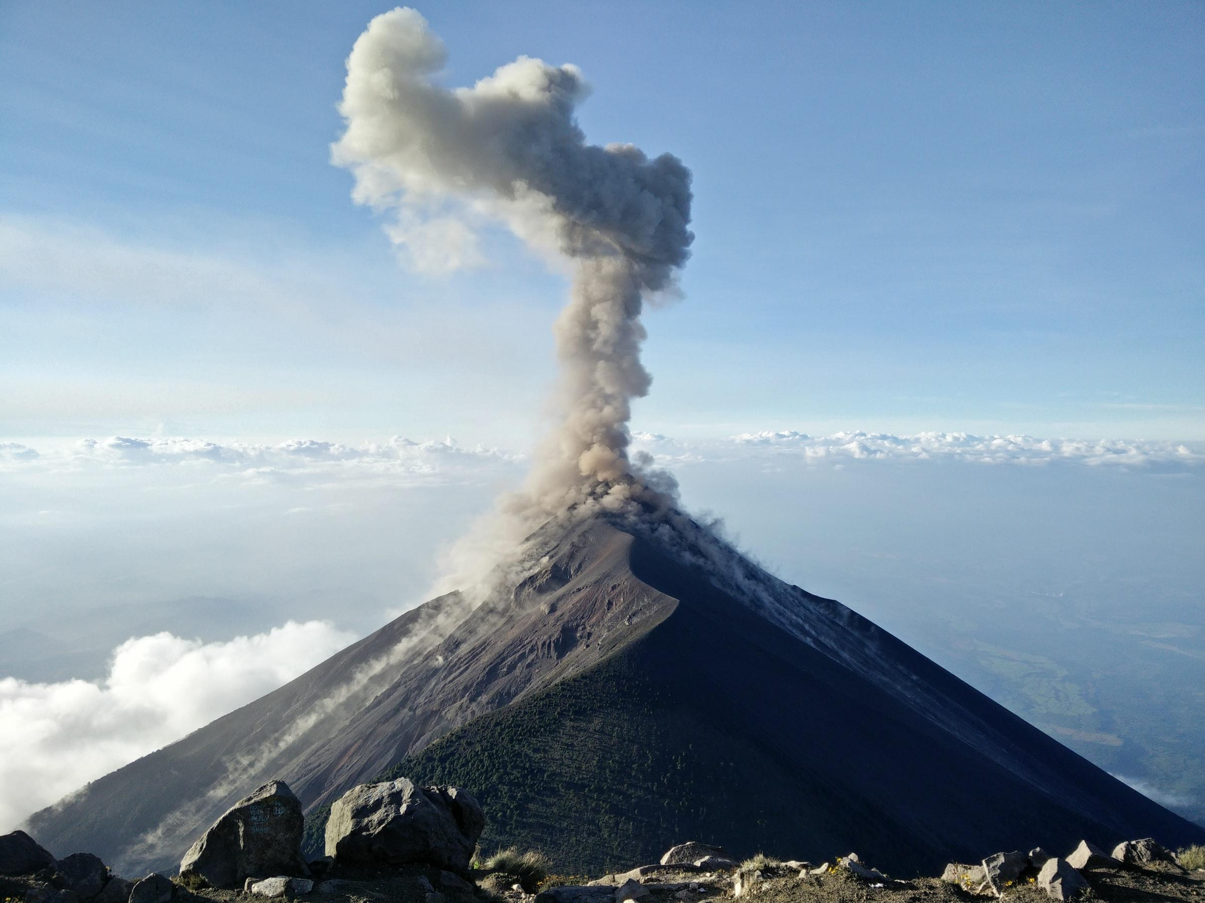
What am I?
Volcano

Slide 16
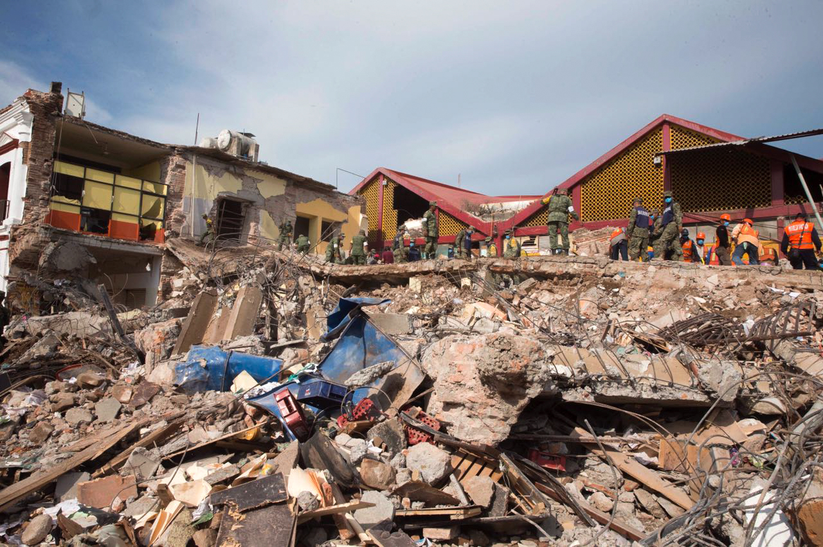
What am I?
Earthquake

Slide 17
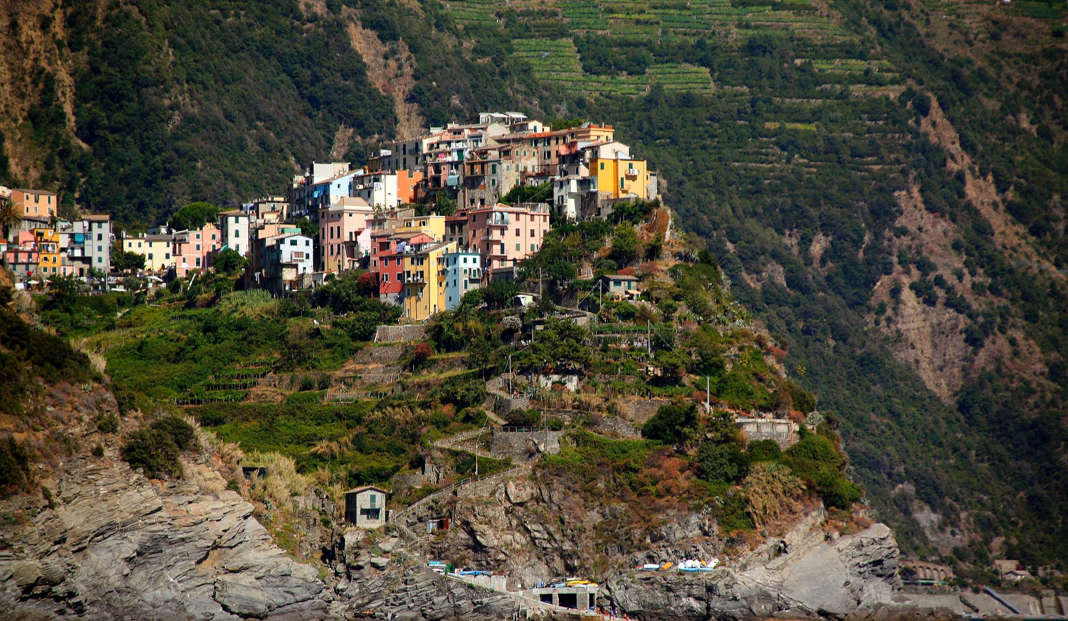
What am I?
Landslide

Slide 18
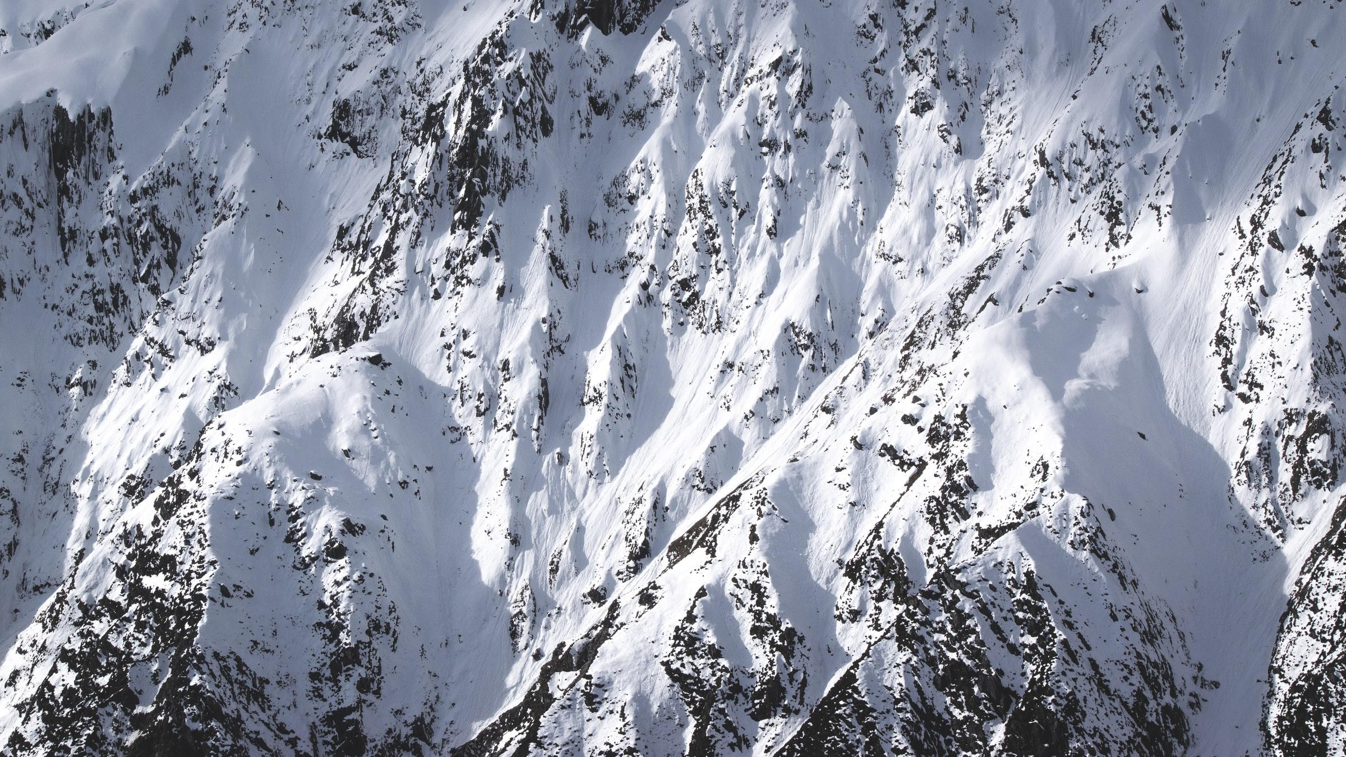
What am I?
Avalanche

Slide 19
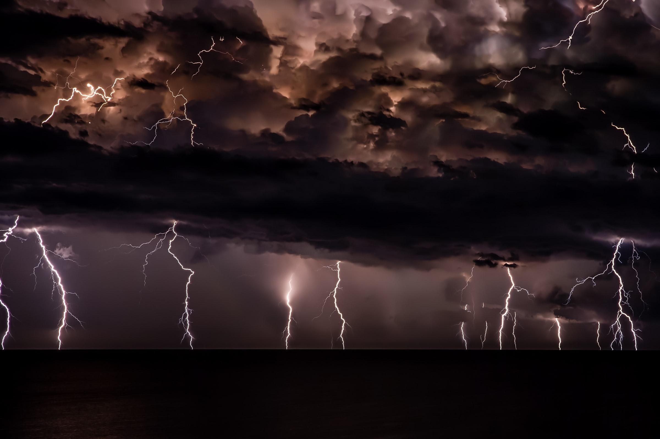
What am I?
Tropical Storm

Slide 20
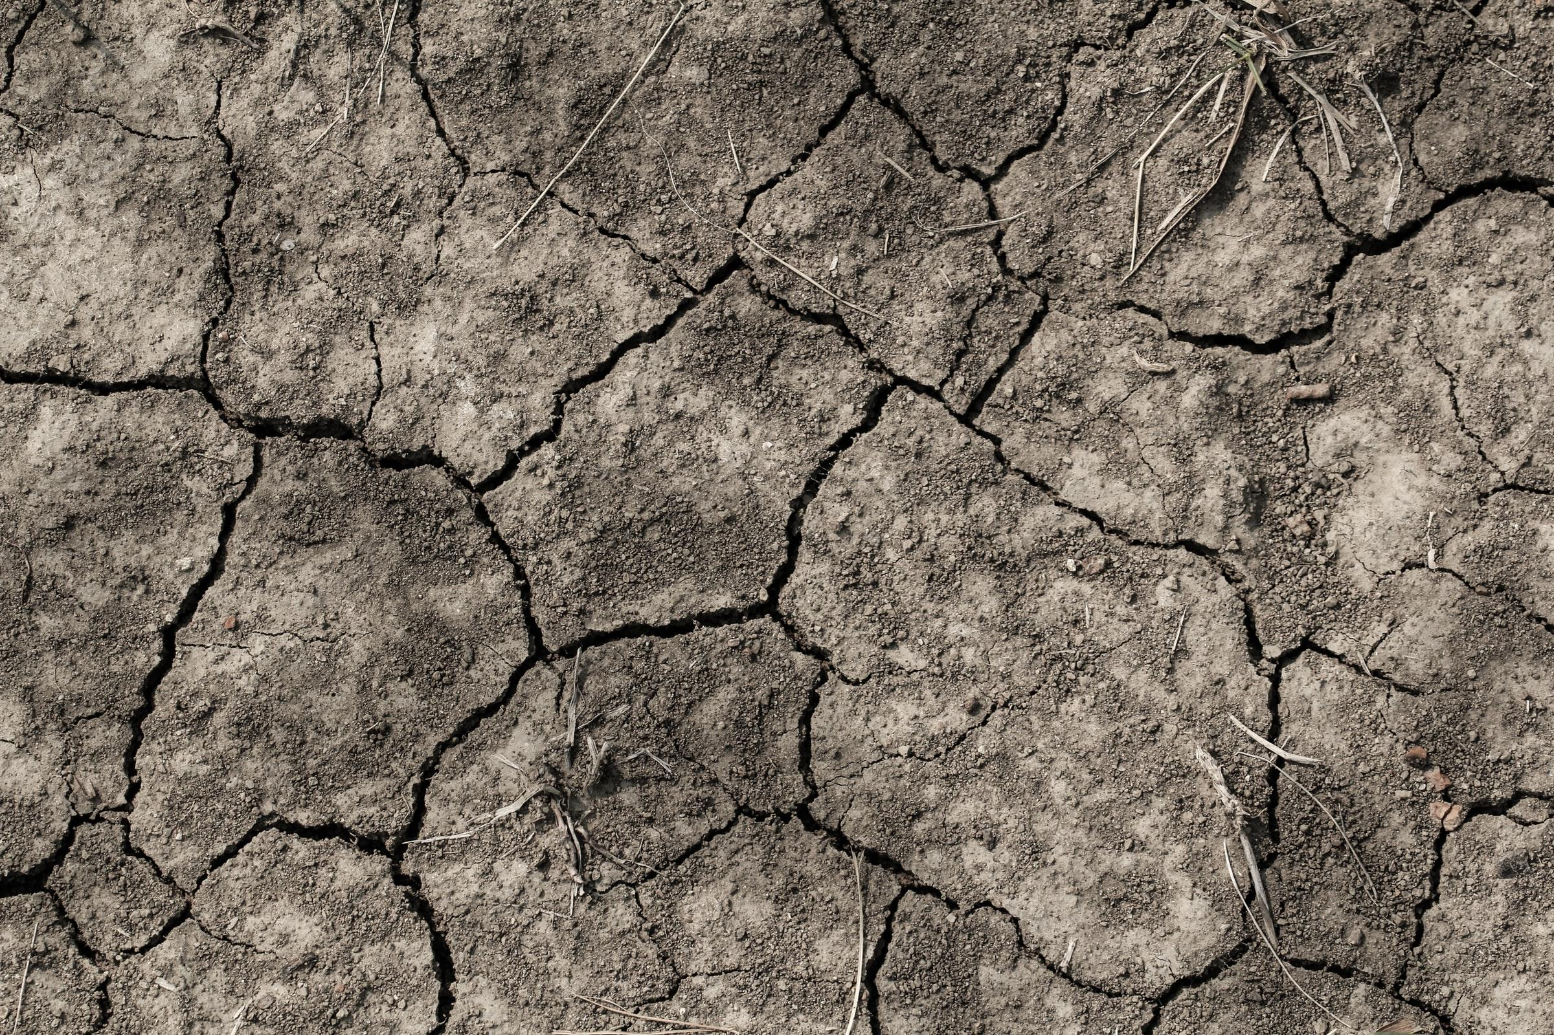
What am I?
Heatwave

Slide 21
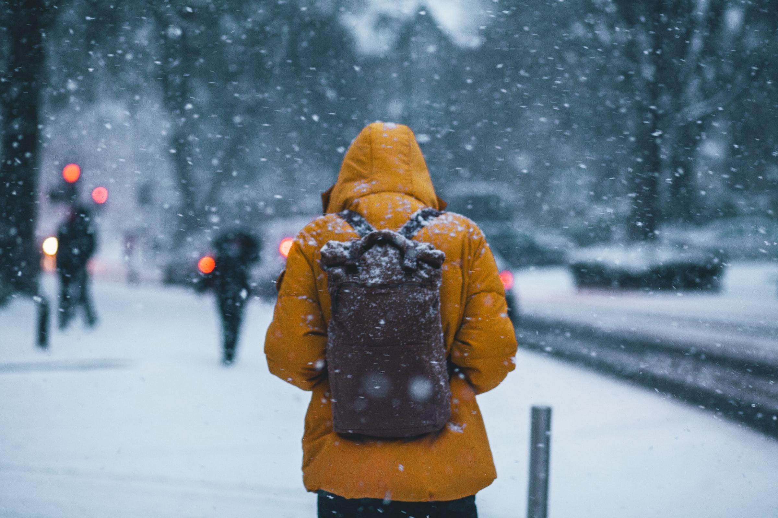
What am I?
Cold spell

Slide 22
Different Things affect the Hazard Risk from Natural Hazards

Slide 23

Task: Pairwork
With your partner, write down any three factors which may affect the hazard risk from natural hazards
You have two minutes before you give feedback to the class / teacher
Hazard Risk is the probability of people being impacted by a hazard in a specific area.

Slide 24
Hazard Risks can be put into three categories
Task: Wall Crawl
Search for the information on the classroom walls and add notes to your tables.
Nature of the Hazard | Vulnerability | Ability to Cope
Hazard Risk is the probability of people being impacted by a hazard in a specific area. There are many things that can determine a hazard:

Slide 25
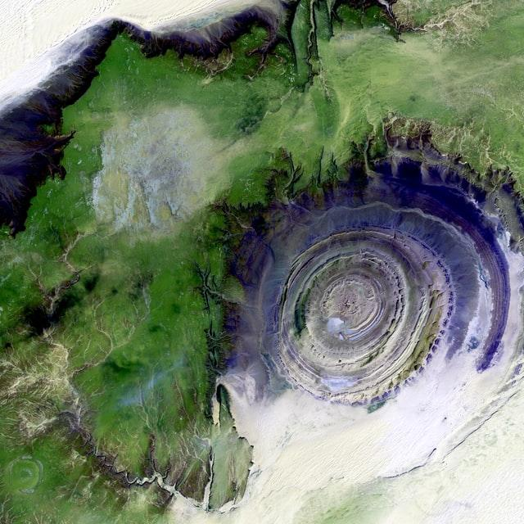
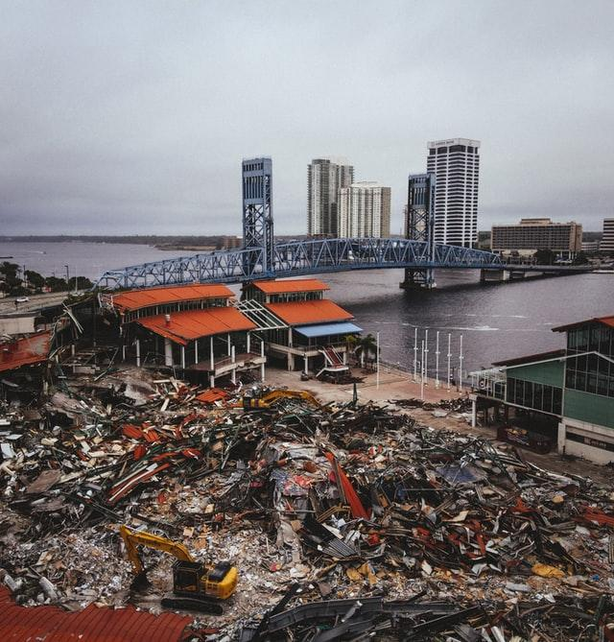

Different Factors Impact the Hazard Risk from Natural Hazards
Nature of Natural Hazards
Type - the risk from some hazards is far greater than others. E.g. tropical storms can be forecasted, enabling people to evacuate and avoid danger. But earthquakes are sudden, and so it’s more difficult to protect people.
Frequency - natural hazards which occur more often may carry a higher risk, thereby affecting people’s lives much more.
Magnitude - more severe natural hazards usually have greater impacts. E.g. the magnitude 9.0 earthquake that struck Japan in 2011 killed almost 16,000 people. However, the 6.3 magnitude earthquake that hit L’Aquila, Italy, in 2009, killed approximately 300 people.
Notes:
Teacher Resource 1
Students to learn independently and teacher can facilitate.
Put this resource at an independent station or location in the classroom.
Collaborative learning: Encourage pair work or teamwork. Students learn faster when they work as part of a team and peer-teach.

Slide 26
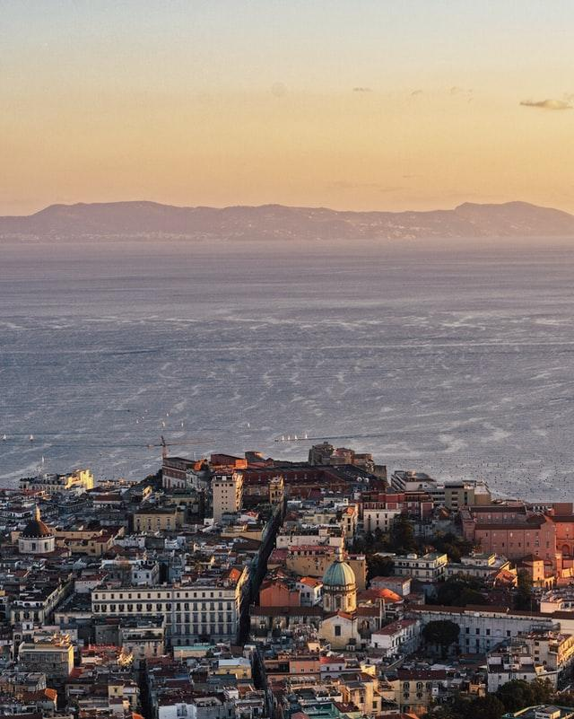
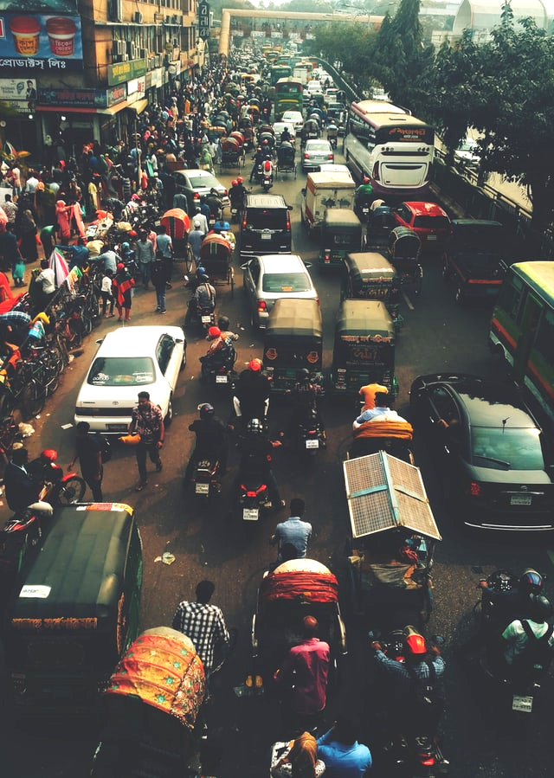
Different Factors Impact the Hazard Risk from Natural Hazards
Vulnerability
The more people that are located in an area exposed to natural hazards, the greater the likelihood they will be impacted by a natural hazard. For example, an area with a high population density on a floodplain, like Bangladesh, is extremely vulnerable to flooding caused by extreme weather, and a city at the base of a volcano, like Naples in Italy, is vulnerable to volcanic eruptions.
Notes:
Teacher Resource 2
Students to learn independently and teacher can facilitate.
Put this resource at an independent station or location in the classroom.
Collaborative learning: Encourage pair work or teamwork. Students learn faster when they work as part of a team and peer-teach.

Slide 27
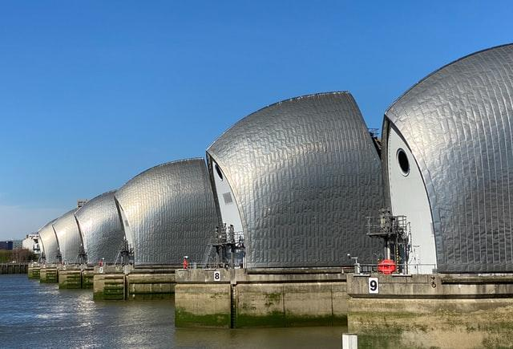
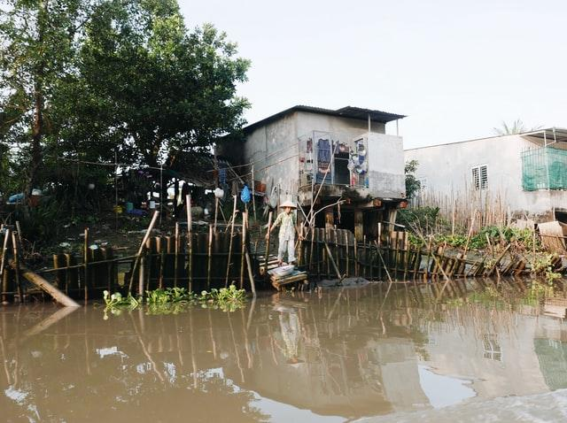
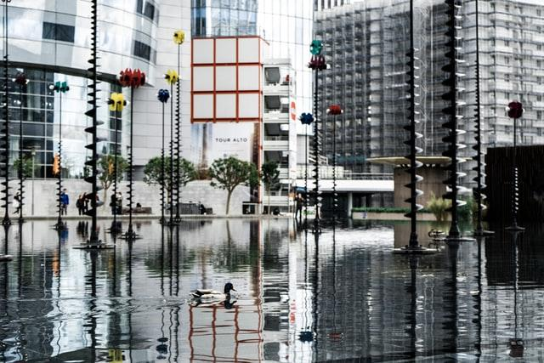
Different Factors Impact the Hazard Risk from Natural Hazards
Ability to Cope
The better a population can deal with an extreme event, the lower the risk of them being seriously impacted. For example, high income countries (HICs) are better able to deal with flood events because they can afford to construct flood defences and evacuate people to safety.
Notes:
Teacher Resource 3
Students to learn independently and teacher can facilitate.
Put this resource at an independent station or location in the classroom.
Collaborative learning: Encourage pair work or teamwork. Students learn faster when they work as part of a team and peer-teach.

Slide 28
Nature of the Hazard | Vulnerability | Ability to Cope
Type - the risk from some hazards is far greater than others. E.g. tropical storms can be forecasted, enabling people to evacuate and avoid danger. But earthquakes are sudden, and so it’s more difficult to protect people. Frequency - natural hazards which occur more often may carry a higher risk, thereby affecting people’s lives much more. Magnitude - more severe natural hazards usually have greater impacts. E.g. the magnitude 9.0 earthquake that struck Japan in 2011 killed almost 16,000 people. However, the 6.3 magnitude earthquake that hit L’Aquila, Italy, in 2009, killed approximately 300 people. | The more people that are located in an area exposed to natural hazards, the greater the likelihood they will be impacted by a natural hazard. For example, an area with a high population density on a floodplain, like Bangladesh, is extremely vulnerable to flooding caused by extreme weather, and a city at the base of a volcano, like Naples in Italy, is vulnerable to volcanic eruptions. | The better a population can deal with an extreme event, the lower the risk of them being seriously impacted. For example, high income countries (HICs) are better able to deal with flood events because they can afford to construct flood defences and evacuate people to safety.
Notes:
Alternative:
Information sheet should be cut up by teacher and put on classroom walls. Students roam the classroom and take notes.
Teacher Resource 4
Students to learn independently and teacher can facilitate.
Put this resource at an independent station or location in the classroom.
Collaborative learning: Encourage pair work or teamwork. Students learn faster when they work as part of a team and peer-teach.

Slide 29

Quiz
What is a meteorological hazard?
something that happens when the earth's crust moves
something that happens when a region has certain weather conditions
something that occurs when the climate becomes too hot and causes a drought
What is a geological hazard?
something that occurs when the earth‘s crust moves
something that happens when a region has certain weather conditions
something that is caused by human activities
Why are higher income countries better able to cope with flooding?
They can afford to build flood defences and evacuate people
There are better swimmers in higher income countries
Higher income countries don’t suffer the same magnitude flood events
Notes:
Answers:
1A
2B
3A

Slide 30
Natural Hazards are extreme events that present a threat to people and places.

Slide 31
Application of Learning

Slide 32
Application of Learning Tasks
Define the term ‘Natural Hazard’.
What were the magnitudes and death rates of two earthquakes you have studied in today’s lesson?
What are the two main categories of natural hazards? Give examples for each.
What are the three main factors which determine hazard risk?
The nature of a natural hazard can affect how badly it impacts people. Explain why with examples.
Why might countries with high population densities be more vulnerable to natural hazards?
High income countries (HICs) can better cope with natural hazards than low income countries (LICs). Why?
Describe the dangers people face in an earthquake or volcano.
How might low income countries, like Bangladesh, better prepare for natural hazards?
Stretch & Challenge:
Why do cities, such as Naples, develop when they are located at the base of a potentially deadly volcano?
How can HIC’s help LICs to better prepare and deal with serious natural hazards?
Notes:
All tasks are based on content found in teacher resources.
Green-coloured questions offer the least challenge for students but nonetheless are essential in assessing for basic understanding of lesson concepts. These would equate to 1-2 mark exam questions where basic understanding is tested.
Amber-coloured questions offer more challenge than green-coloured questions. These are intended to check more more comprehensive understanding about the lesson content where the student will be expected to compare and contrast, or explain concepts in more detail. These would equate to 2-3 mark exam questions.
Red-coloured questions are a higher challenge question where students will be expected to tie in different lesson concepts, and consider effects, impacts, threats, vulnerabilities from a social, economic, environmental, technological and even political perspective. Students are expected to think in a more dynamic context rather than in just a linear fashion, in order to give deeper explanation or discussion about concepts and topics. These equate to 4-8 mark exam questions.
Purple-coloured questions are designed to test the most highly capable students, thereby stretch and challenge them. These questions, whilst relevant to the lesson content, will expect students to draw upon their wider geographical knowledge and utilise knowledge from other geography topics, not to mention current affairs and general knowledge. Students will be expected to think critically and to provide deeper insight, opinion, discussion and explanation in their responses. Stretch and Challenge tasks are designed to do exactly as the term suggests. This allows talented students to think more outside the box and utilise wider academic knowledge they may have.

Slide 33
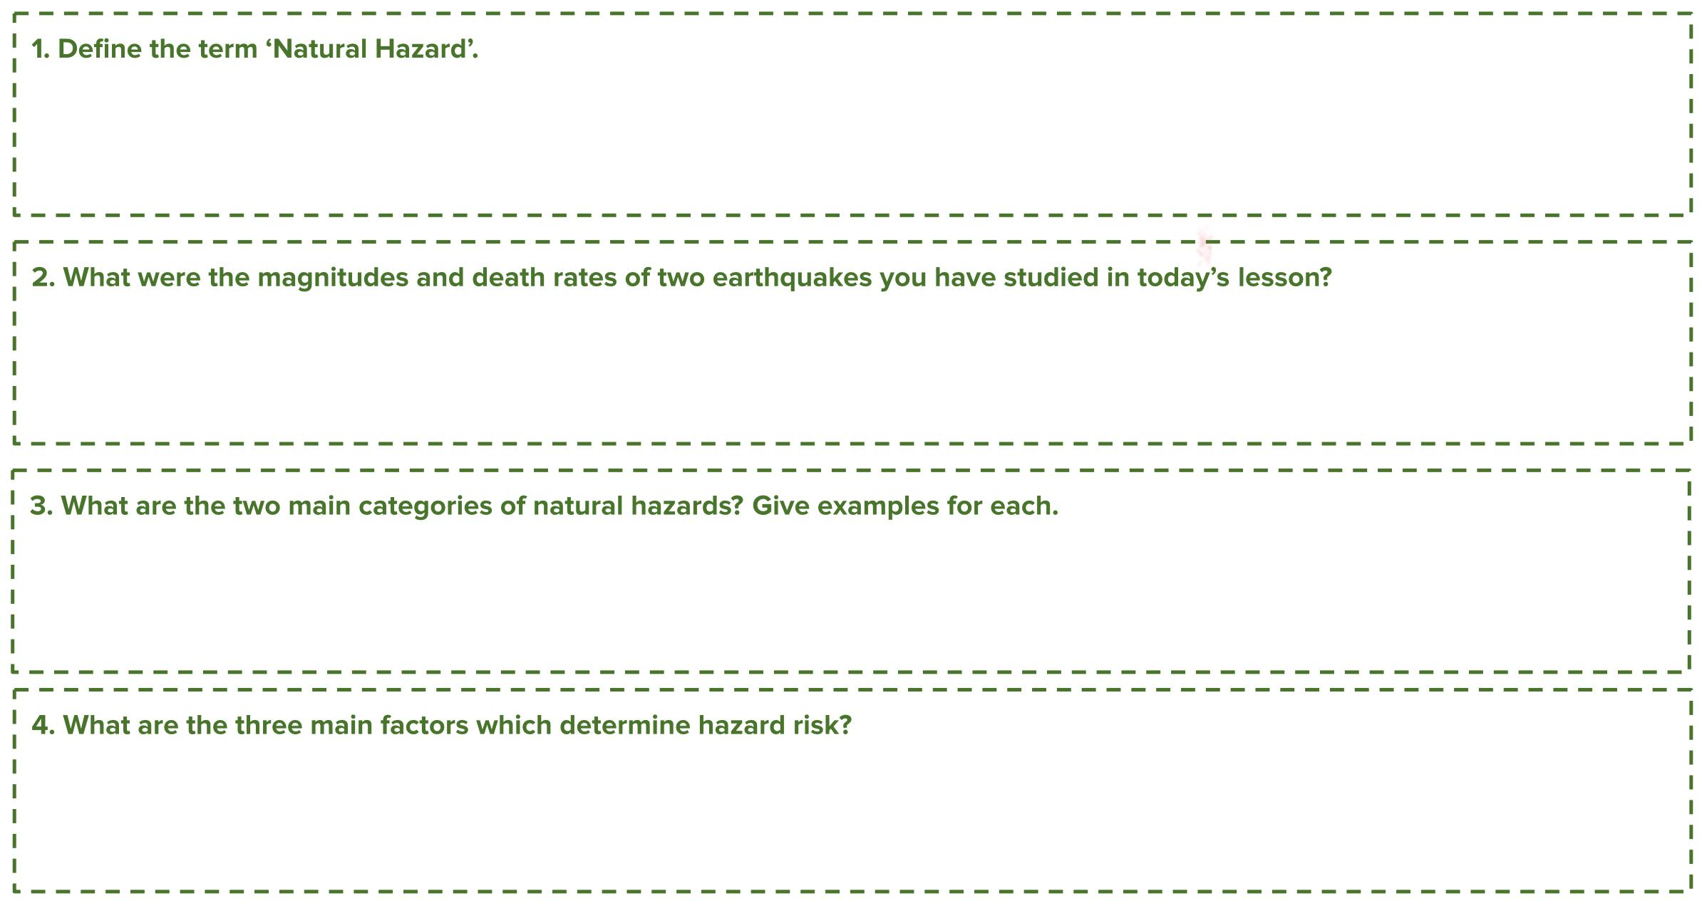
Type answer here
Type answer here
Type answer here
Type answer here
Notes:
Green-coloured questions offer the least challenge for students but nonetheless are essential in assessing for basic understanding of lesson concepts. These would equate to 1-2 mark exam questions where basic understanding is tested.

Slide 34
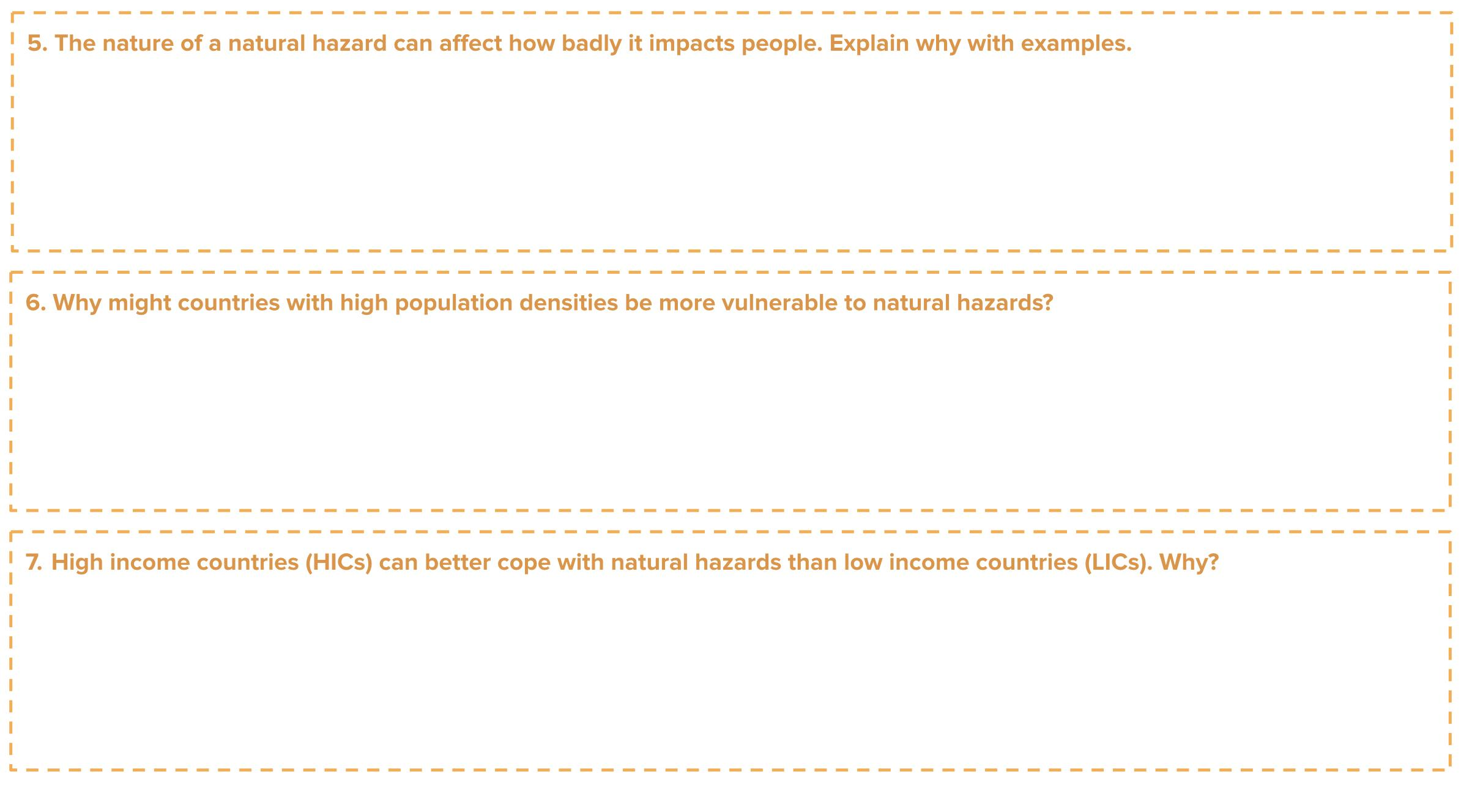
Type answer here
Type answer here
Type answer here
Type answer here
Notes:
Amber-coloured questions offer more challenge than green-coloured questions. These are intended to check more more comprehensive understanding about the lesson content where the student will be expected to compare and contrast, or explain concepts in more detail. These would equate to 2-3 mark exam questions.

Slide 35
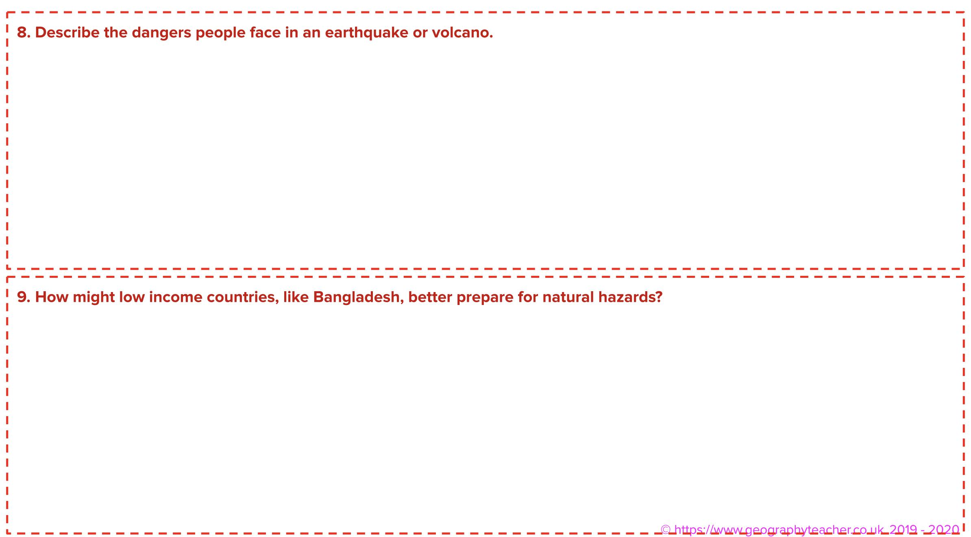
Type answer here
Type answer here
Notes:
Red-coloured questions are a higher challenge question where students will be expected to tie in different lesson concepts, and consider effects, impacts, threats, vulnerabilities from a social, economic, environmental, technological and even political perspective. Students are expected to think in a more dynamic context rather than in just a linear fashion, in order to give deeper explanation or discussion about concepts and topics. These equate to 4-8 mark exam questions.

Slide 36
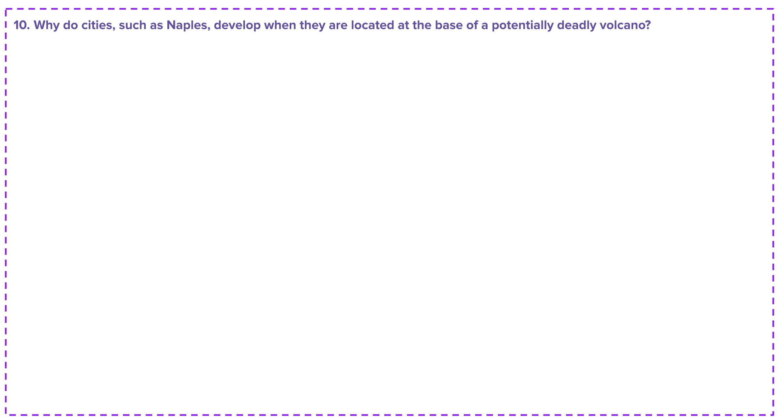
Type answer here
Notes:
Purple-coloured questions are designed to test the most highly capable students, thereby stretch and challenge them. These questions, whilst relevant to the lesson content, will expect students to draw upon their wider geographical knowledge and utilise knowledge from other geography topics, not to mention current affairs and general knowledge. Students will be expected to think critically and to provide deeper insight, opinion, discussion and explanation in their responses.

Slide 37

Type answer here
Notes:
Purple-coloured questions are designed to test the most highly capable students, thereby stretch and challenge them. These questions, whilst relevant to the lesson content, will expect students to draw upon their wider geographical knowledge and utilise knowledge from other geography topics, not to mention current affairs and general knowledge. Students will be expected to think critically and to provide deeper insight, opinion, discussion and explanation in their responses.

Slide 38

Journal Entry
You are on holiday in D’Avila, Italy when the volcano suddenly erupts. Write a journal entry describing how you feel, what you can see, what you can hear, what you can smell and your hopes and fears for the future.
Notes:
Refer to writing frame on the next page to help students

Slide 39
Writing Framework
What do you think language
I think that…
I believe…
In my opinion…
In my view…
It is my belief that …
It is clear to see…
Give examples
Such as
In the case of
For example
As revealed by
For instance
Explain an idea
Although
Except
Unless
However
Therefore
Sequencing
Firstly
Secondly
Next
Finally afterwards
Since
Adding to
And
Also
As well as
Moreover
Too
Furthermore
Cause and effect
Because
So
Therefore
Consequently
Thus
Contrasting
Whereas
Instead of
Alternatively
Otherwise
In another way
Then again
Elaborating your ideas
This suggests
This shows
This infers
This signifies
This implies
This portrays
This conveys
This means
Therefore
However
Furthermore
To emphasise
Above all
Ultimately
Especially
Significantly
To compare
Likewise
Equally
In the same way
Similarly
Notes:
Writing framework to help students with their creative writing tasks.

Slide 40
Final Plenary

Slide 41
Plenary
What is a natural hazard?
The two main categories of natural hazards are…….
Hazard risk is……
Hazard risk is determined by…….
Highly densely populated countries tend to be less at risk to natural hazards. True or False?
Low income countries usually cope better with natural hazards than high income countries. True or False?
Notes:
This links back to lesson objectives at the beginning of class.

Slide 42


Retweet
Retweet an answer to the question in no more than 140 characters:
Question:
Notes:
Students or teacher to provide write an end-of-lesson plenary question to assess student learning. Student is given 5 minutes to provide an answer to the question, on no more than 140 characters.
Students can share questions and answers in class.
This provides the teacher with useful assessment for learning feedback on the individual student ot the entire class.

Slide 43

Retweet an answer to the question in no more than 140 characters
Type plenary question here
Notes:
Students or teacher to provide write an end-of-lesson plenary question to assess student learning. Student is given 5 minutes to provide an answer to the question, on no more than 140 characters.

Slide 44
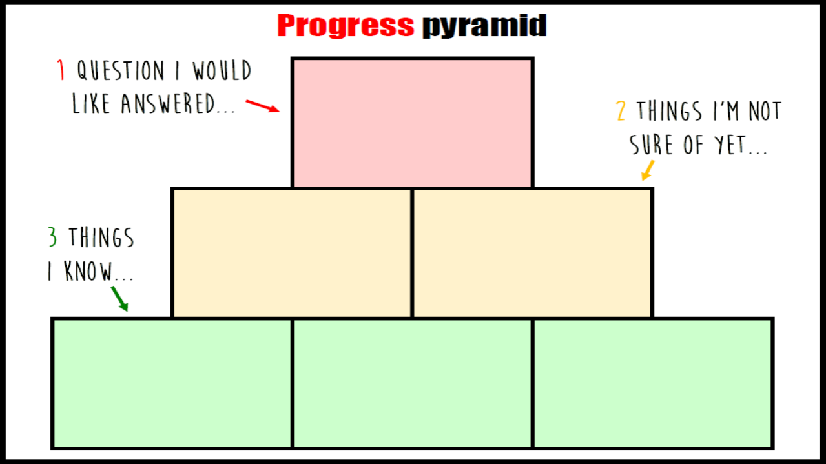
Notes:
Classroom written version

Slide 45
Type here
Type here
Type here
Type here
Type here
Type here
Notes:
Online distance learning digital text input version

Slide 46

Notes:
Exit cards for - Assessment for Learning

Slide 48
Teacher Resources

Slide 49
Different Factors Impact the Hazard Risk from Natural Hazards
Nature of Natural Hazards
Type - the risk from some hazards is far greater than others. E.g. tropical storms can be forecasted, enabling people to evacuate and avoid danger. But earthquakes are sudden, and so it’s more difficult to protect people.
Frequency - natural hazards which occur more often may carry a higher risk, thereby affecting people’s lives much more.
Magnitude - more severe natural hazards usually have greater impacts. E.g. the magnitude 9.0 earthquake that struck Japan in 2011 killed almost 16,000 people. However, the 6.3 magnitude earthquake that hit L’Aquila, Italy, in 2009, killed approximately 300 people.
Notes:
Teacher Resource 1
Students to learn independently and teacher can facilitate.
Put this resource at an independent station or location in the classroom.
Collaborative learning: Encourage pair work or teamwork. Students learn faster when they work as part of a team and peer-teach.

Slide 50
Different Factors Impact the Hazard Risk from Natural Hazards
Vulnerability
The more people that are located in an area exposed to natural hazards, the greater the likelihood they will be impacted by a natural hazard. For example, an area with a high population density on a floodplain, like Bangladesh, is extremely vulnerable to flooding caused by extreme weather, and a city at the base of a volcano, like Naples in Italy, is vulnerable to volcanic eruptions.
Notes:
Teacher Resource 2
Students to learn independently and teacher can facilitate.
Put this resource at an independent station or location in the classroom.
Collaborative learning: Encourage pair work or teamwork. Students learn faster when they work as part of a team and peer-teach.

Slide 51
Different Factors Impact the Hazard Risk from Natural Hazards
Ability to Cope
The better a population can deal with an extreme event, the lower the risk of them being seriously impacted. For example, high income countries (HICs) are better able to deal with flood events because they can afford to construct flood defences and evacuate people to safety.
Notes:
Teacher Resource 3
Students to learn independently and teacher can facilitate.
Put this resource at an independent station or location in the classroom.
Collaborative learning: Encourage pair work or teamwork. Students learn faster when they work as part of a team and peer-teach.

Slide 52
Nature of the Hazard | Vulnerability | Ability to Cope
Type - the risk from some hazards is far greater than others. E.g. tropical storms can be forecasted, enabling people to evacuate and avoid danger. But earthquakes are sudden, and so it’s more difficult to protect people. Frequency - natural hazards which occur more often may carry a higher risk, thereby affecting people’s lives much more. Magnitude - more severe natural hazards usually have greater impacts. E.g. the magnitude 9.0 earthquake that struck Japan in 2011 killed almost 16,000 people. However, the 6.3 magnitude earthquake that hit L’Aquila, Italy, in 2009, killed approximately 300 people. | The more people that are located in an area exposed to natural hazards, the greater the likelihood they will be impacted by a natural hazard. For example, an area with a high population density on a floodplain, like Bangladesh, is extremely vulnerable to flooding caused by extreme weather, and a city at the base of a volcano, like Naples in Italy, is vulnerable to volcanic eruptions. | The better a population can deal with an extreme event, the lower the risk of them being seriously impacted. For example, high income countries (HICs) are better able to deal with flood events because they can afford to construct flood defences and evacuate people to safety.
Notes:
Alternative:
Information sheet should be cut up by teacher and put on classroom walls. Students roam the classroom and take notes.
Teacher Resource 4
Students to learn independently and teacher can facilitate.
Put this resource at an independent station or location in the classroom.
Collaborative learning: Encourage pair work or teamwork. Students learn faster when they work as part of a team and peer-teach.

Slide 53
Nature of the Hazard | Vulnerability | Ability to Cope
Type - the risk from some hazards is greater than others. E.g. tropical storms can be forecasted, allowing people to evacuate. But earthquakes are sudden, and so its more difficult to protect people. Frequency - natural hazards which occur more often may carry a higher risk, thereby affecting people’s lives more. Magnitude - more severe natural hazards usually have greater impacts. E.g. the magnitude 9.0 earthquake that struck Japan in 2011 killed almost 16,000 people. However, the 6.3 magnitude earthquake that hit L’Aquila, Italy, in 2009, killed approximately 300 people. | The more people that are located in an area exposed to natural hazards, the greater the likelihood they will be impacted by a natural hazard. For example, an area with a high population density on a floodplain, like Bangladesh, is extremely vulnerable to flooding caused by extreme weather, and the city at the base of a volcano, like Naples in Italy, is vulnerable to volcanic eruptions. | The better a population can deal with an extreme event, the lower the risk of them being seriously impacted. For example, higher income countries (HICs) are better able to deal with flood events because they can afford to construct flood defences and evacuate people to safety.
Notes:
Cut up into the three column sections. To be distributed around the classroom.

Slide 54
Hazard Risk is determined by different variables:
Nature of the Hazard | Vulnerability | Ability to Cope
Notes:
Students take notes from information distributed around the classroom.

